Slide 1
Housing Prices
Recommending housing prices in newer residential markets
By: Franklin Vanjour

Slide 2

Introduction
RealCo is a Real Estate firm in the state of California. Core business: Buying and Selling of houses in the state of California
Business Need: Expand business by trading in residential areas not traded in before (areas new to the firm)

Slide 3

Problem Statement
Dave (IT manager) at RealCo requests Frank, a freelance Data Scientist, to use Predictive Analytics to predict the Median Housing Value in the new residential areas.
The prediction needs to be based on the patterns of recent sales history in the surrounding areas

Slide 4
Dataset
Data: Recent Sales History
Instances: 20K rows (residential localities)
Target: Median House Value
Features:
Median Income
Median House Age
Average Number of Rooms
Average Number of Bedrooms
Population
Average House Occupancy
Latitude
Longitude

Slide 5
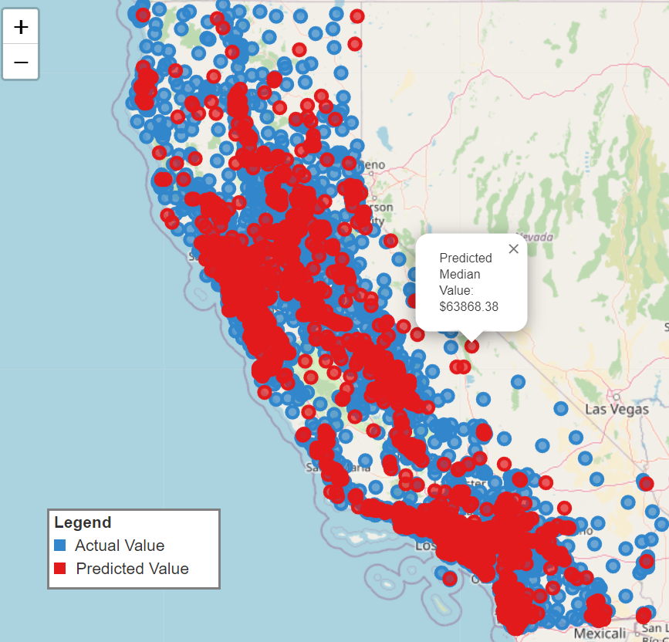
Business Value
Realco uses the predicted Median House Value for their further analysis to identify ways to increase Profit Margins via:
Optimal Purchase Price
Optimal Sale Price
Profitable Locality identification

Slide 6
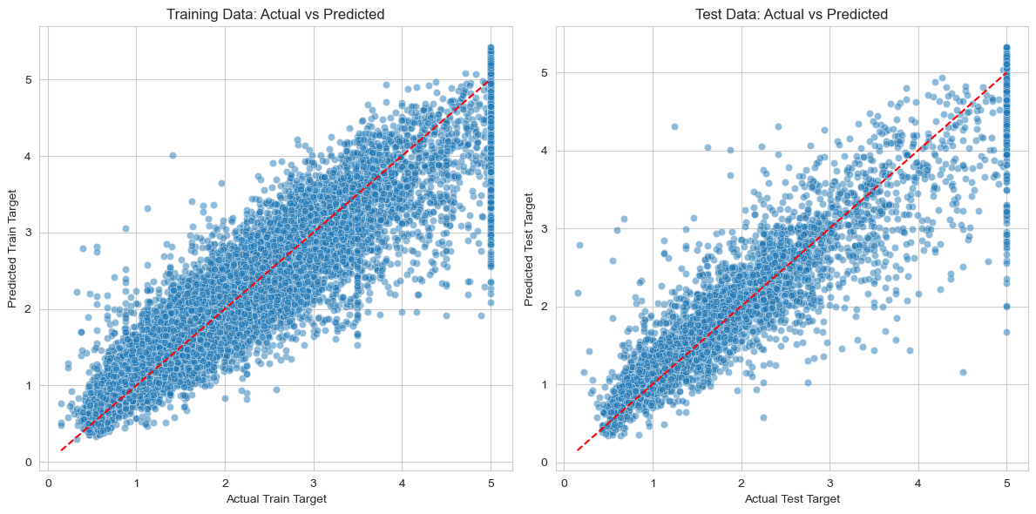
Model Performance
R² Score
Train: 87.01%
Test: 81.59%

Slide 7
Challenges / Highlights
Highlights
Folium library for Plotting on Maps
Optimizing R² score
Feature selection
Scaler selection (Best: Standard)
Model selection (Best: GradientBoostingRegressor)
Hyper-param tuning
Challenges
Identifying Dataset
GridSearchCV with RandomForestRegressor
Insufficient Time for further optimization

Slide 8
Thank You

